Slide 1
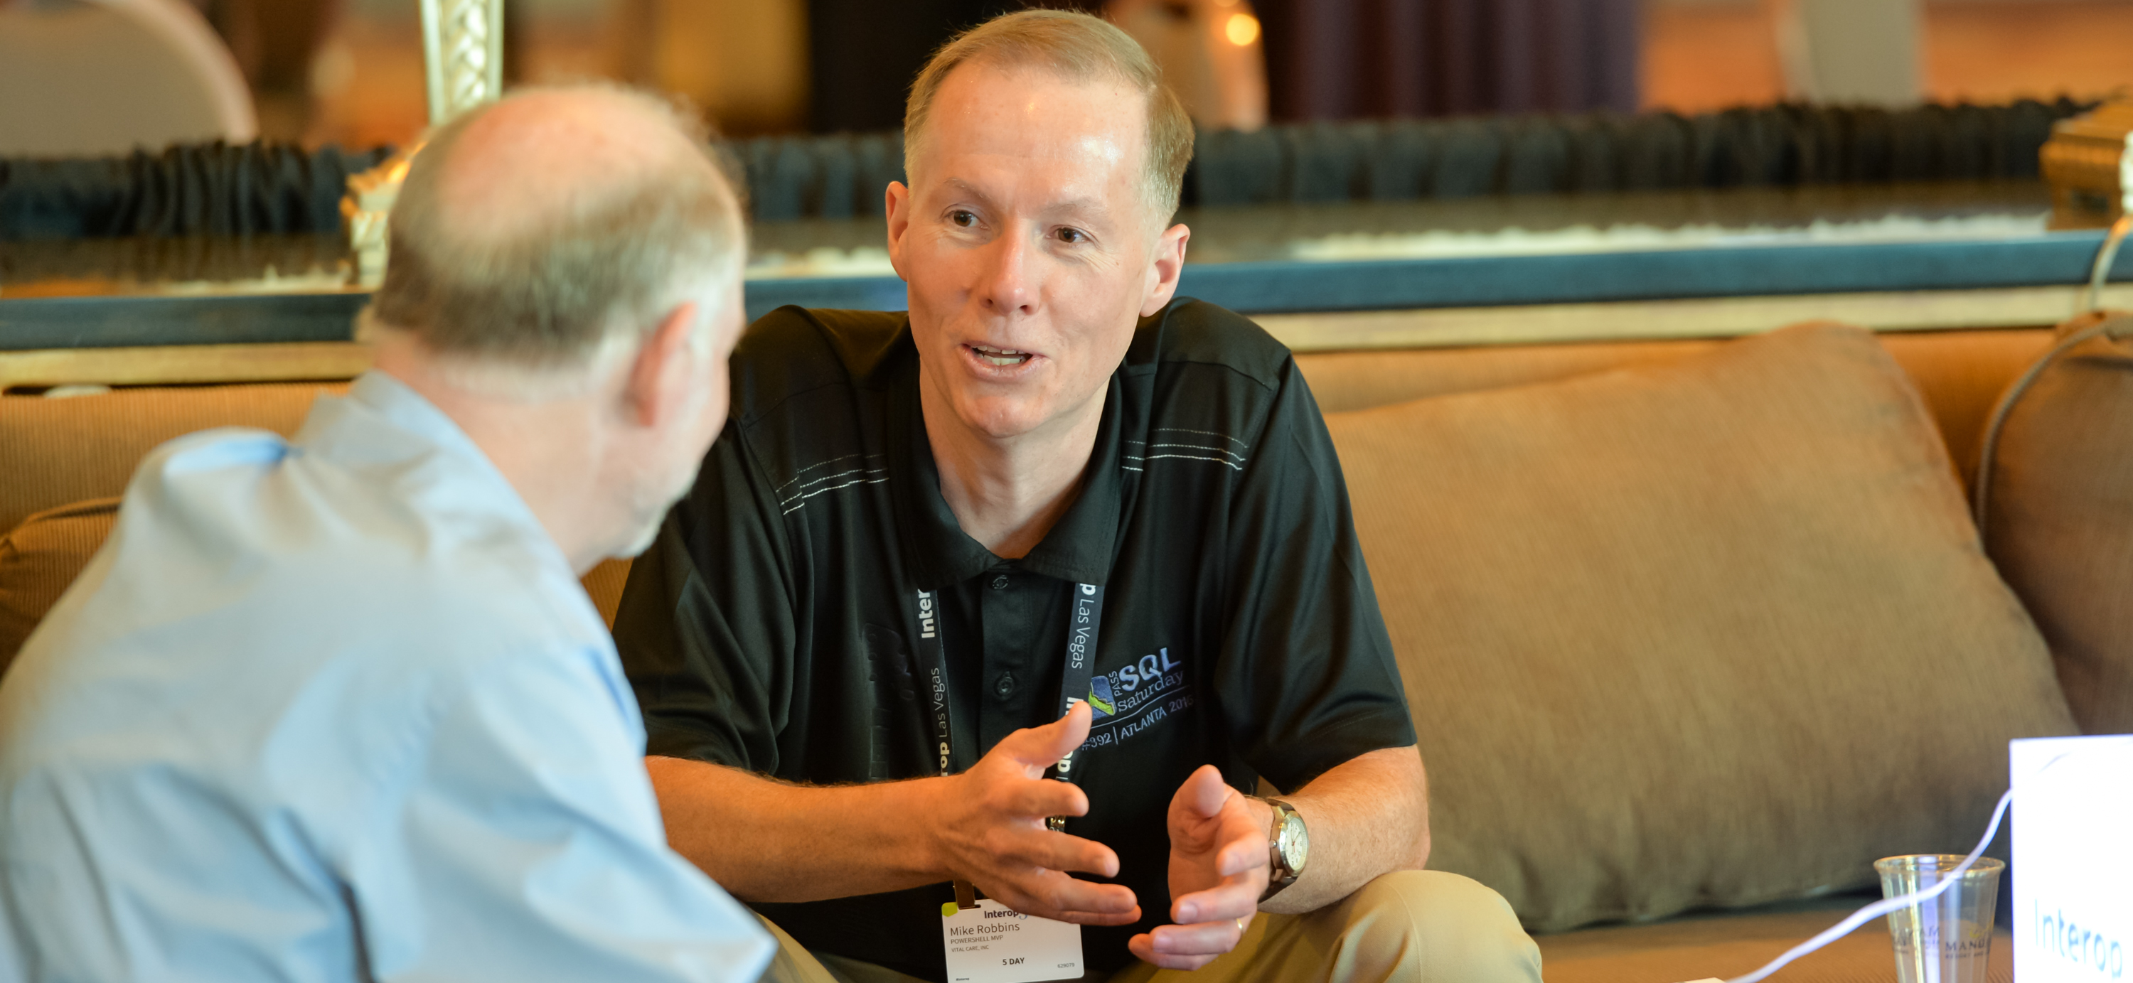


Closing
remarks
OnRamp Team

Slide 2
Key takeaways for success
Your job is not your career
Activity is not equal to productivity
Focus on impact, not activity
Individual accomplishments
Contribute to the success of others
Results that build on the work, ideas, and efforts of others

Slide 3
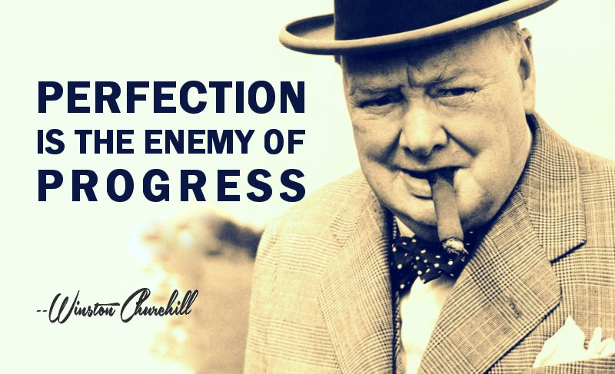
Perfection is the enemy of progress

Slide 4


Recommended books

Slide 5
Get-Contact –Identity 'Presenter'
Blog: mikefrobbins.com
Bluesky: @mikefrobbins.com
LinkedIn: www.linkedin.com/in/mikefrobbins
GitHub: github.com/mikefrobbins

Slide 6


